Slide 1
CONTENTS
POWER ELECTRONICS-1
1-Introduction to Power Electronics
2-Semiconductor Devices a)Diode d)BJT
b)Thyristor e)MOSFET
c)GTO f)IGBT
3-Rectifiers a)Midpoint Rectifiers a)Uncontrolled Rectifiers a)Single Phase Rectifiers
b)Bridge Rectifiers b)Full-Controlled Rectifers b)Three Phase Rectifiers
c)Half-Wave Controlled Rect.
4-Practical Aspects of Rectifier Circuit
5-Cooling

Slide 2
Introduction to Power Electronics
Learning Objectives
Understand what we mean by “ power electronics.”
Understand the issues, and potential applications and challenges of power electronics.
Encourage further reading on power electronics and its applications.

Slide 3
Presentation Overview
What We Mean by Power Electronics?
Power Electronics Systems
Types of Power Converters
Power Semiconductor Devices
Examples of Applications
Specifications of Power Electronics Systems
Issues of Power Electronics
Conclusion
IEEE Resources

Slide 4
What We Mean by Power Electronics?
Uses semiconductor devices as switches for power conversion from one type of source to another.
Uses solid-state electronics for efficient control of the amount of power and energy flow.
Applies control techniques in order to obtain the desired input and output requirements.
We can say that Power Electronics combine Power, Electronics and Control.
Thus we can define Power Electronics as the applications of solid-state electronics for the control and conversion of electric power.

Slide 5
Power Electronics System
Consists of an input source and a load.
One or more converters for power conversion.
Power semiconductor devices, which are used as switches to perform the power conversion.
A gating circuit to generate the gate drive signals for the switching devices.
A feedback control circuit implemented either in analog and/or digital electronics.
One or more static-switches acting as a circuit breaker.

Slide 6
Types of Power Converters
Converters are generally classified into four types:
    AC-DC converter, also called as a rectifier.
    AC-AC converter, also called as an ac voltage controller.
    DC-DC converter, also called as a dc chopper.
    DC-AC converter, also called as an inverter.

Slide 7
Power Semiconductor Devices
Power devices are the key elements of a power
converter. The commonly used devices are:
1) Power Diode
2) Silicon-Controlled Rectifier (SCR) or Thyristor
3) Gate Turn-off Thyristor (GTO)
4) Power Bipolar Junction Transistor (Power BJT)
5) Power Metal-Oxide Field-Effect Transistor (Power MOSFET)
6) Insulated-Gate Bipolar Transistor (IGBT)
7) Mos-Controlled Thyristor (MCT)

Slide 8
Diode
Uncontrollable switch
  On & off are determined by current in the circuit.
Conduct positive on-state current.
Block negative off-state voltage

Slide 9
Thyristor (SCR )
SCR:Silicon Controlled Rectifier
Semi-controllable switch
  Turn on by positive current pulse trains if v >0
  Uncontrollable turn off
  Needs commutation circuit
Conduct positive on-state current.
Block positive & negative off-state voltage.
i
On state
Off state
V
Reversed blocked

Slide 10
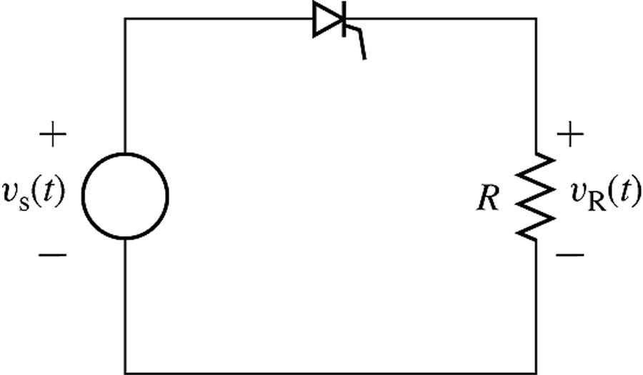
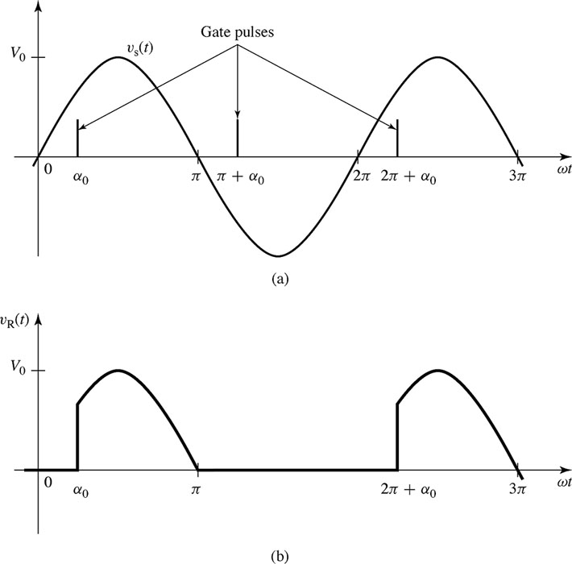
SCR
Example
Vs=Vo sinwt

Slide 11
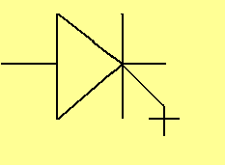
Gate Turn-Off (GTO) Thyristor
By applying a positive current to gate of GTO, it switches from off state to on state.
By applying a negative current to gate of GTO, it switches from on state to off state.
GTO can be turned off with a negative gate current.

Slide 12
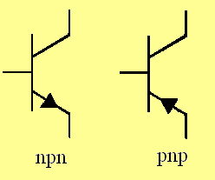
Bipolar Junction Transistor (BJT)
Controllable switch
  Base current
  Cutoff & saturation regions
Conduct positive on-state current.
Block positive off-state voltage

Slide 13
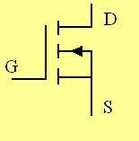
MOSFET
MOSFET : Metal-Oxide Semiconductor Field Effect Transistor
Controllable switch
  Gate voltage
Free-wheeling diode is embedded internally.
Conduct positive on-state current (can also conduct negative current).
Block positive off-state voltage

Slide 14
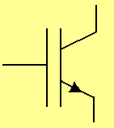
IGBT
IGBT : Insulated Gate Bi-polar Transistor
gate controls conduction, switching the device on and off;
far faster than thyrisitor, can operate at 10s kHz;
is a transistor, so will not take reverse voltage (usually a built-in reverse diode;
dissipates significant power during switching;
is available at up to 1 kV forward, 100s A average.

Slide 15
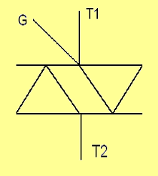
Triac
If T1-T2 forward biased, it conducts “+” pulse is applied to G.
If T1-T2 reverse biased, it conducts “-” pulse is applied to G.
Triacs are mostly used with resistive loads and at frequencies below 400Hz.

Slide 16
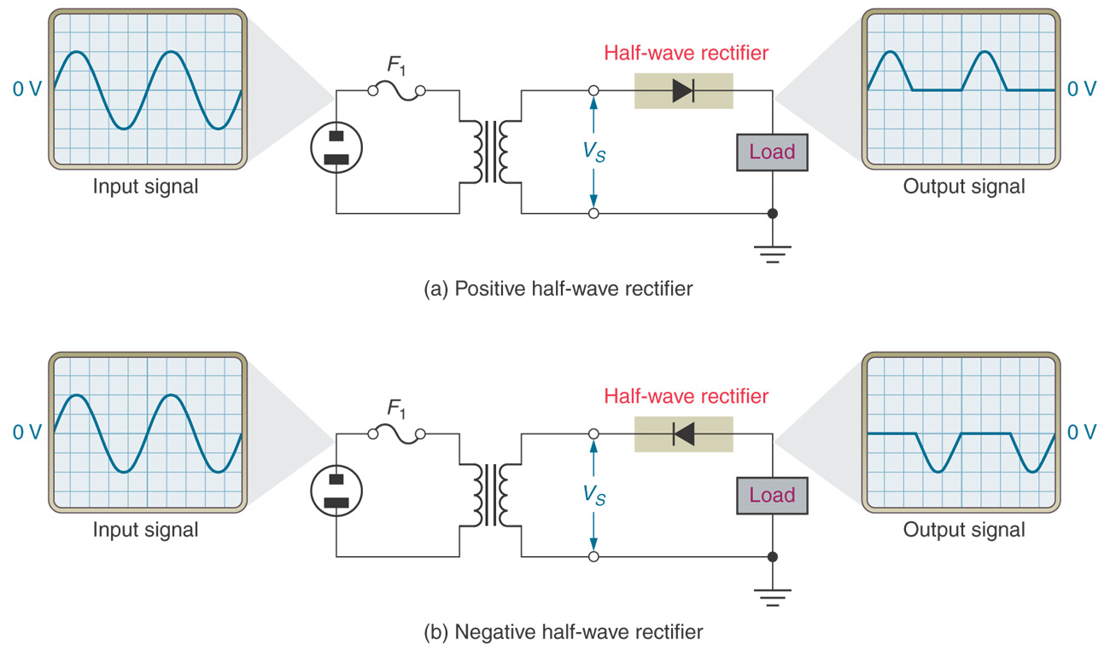
HALF WAVE RECTIFIERS

Slide 17
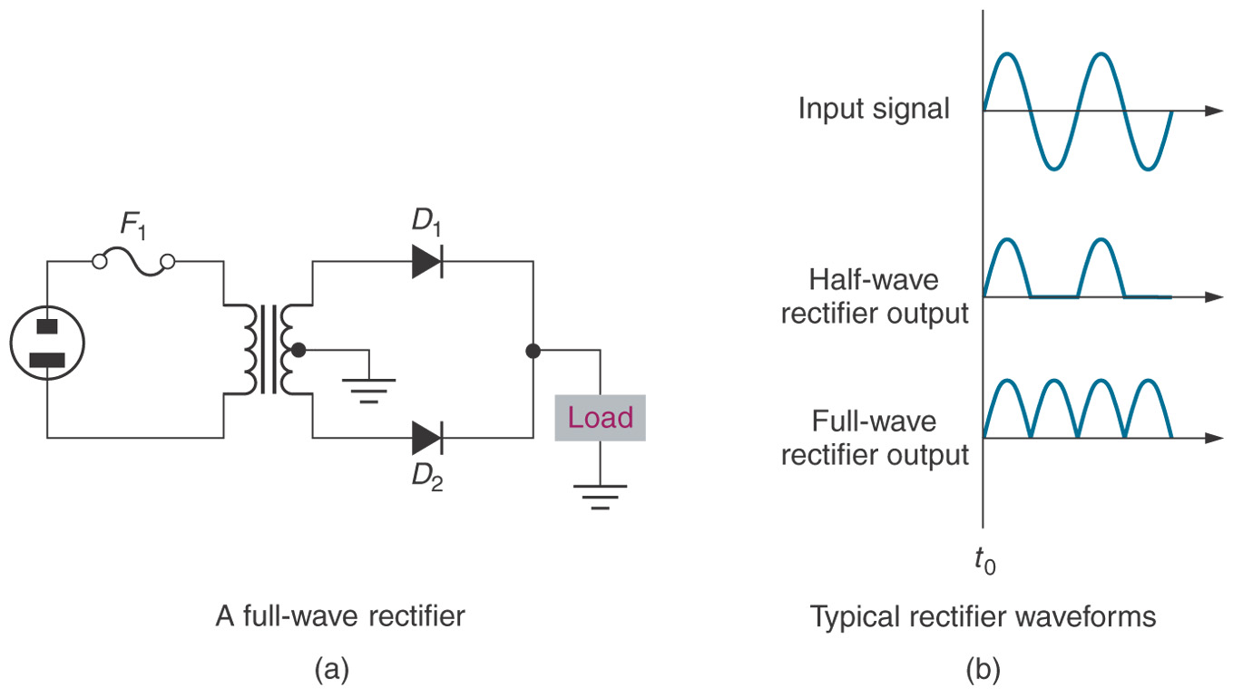
FULL WAVE MIDPOINT RECTIFIERS

Slide 18
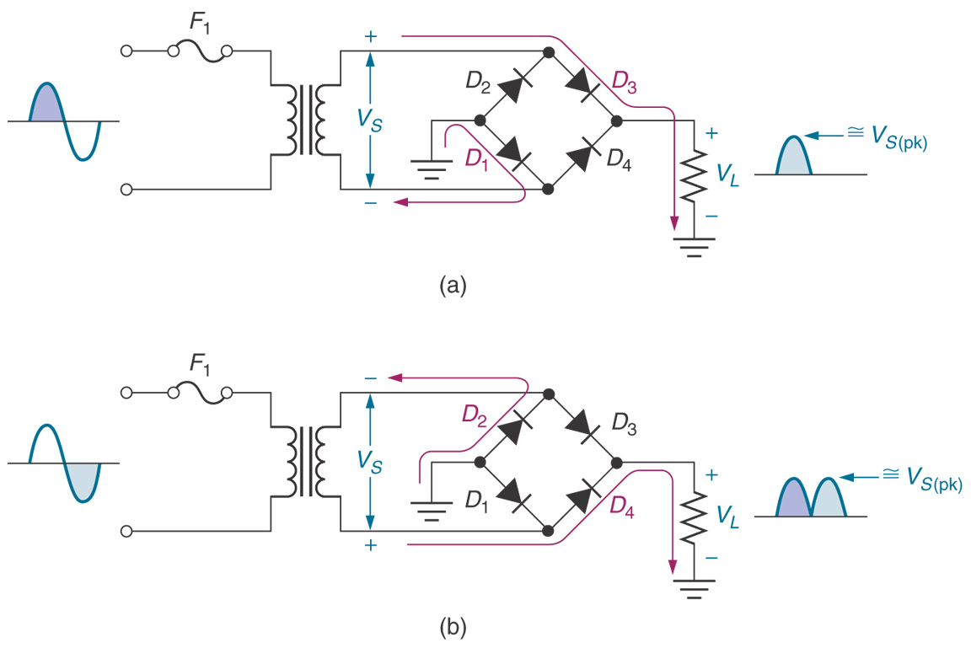
FULL WAVE BRIDGE RECTIFIERS

Slide 19
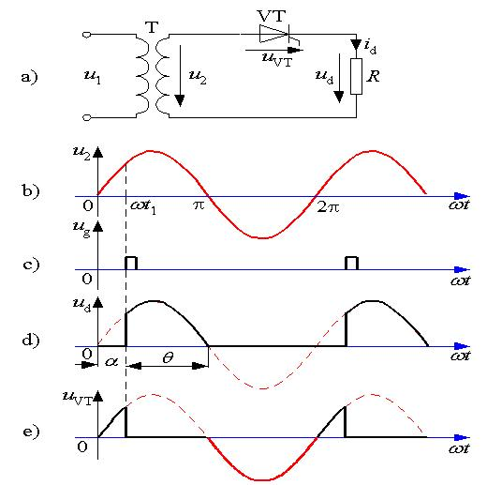
SINGLE PHASE HALF WAVE CONTROLLED RECTIFIERS
Load is resistive

Slide 20
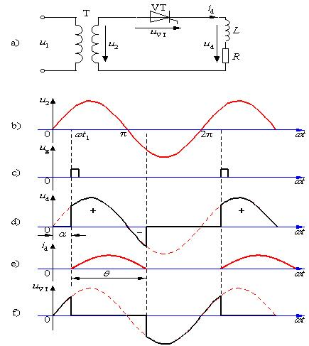
Load is inductive

Slide 21
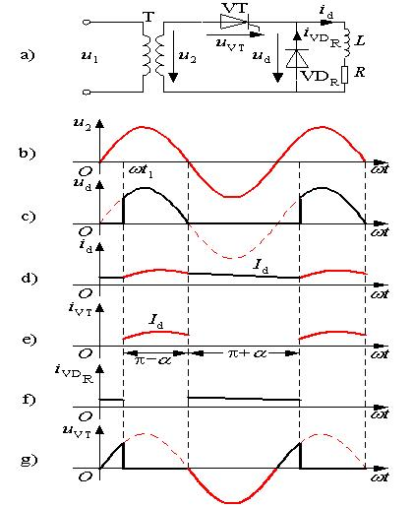
Rectifier with FWD

Slide 22
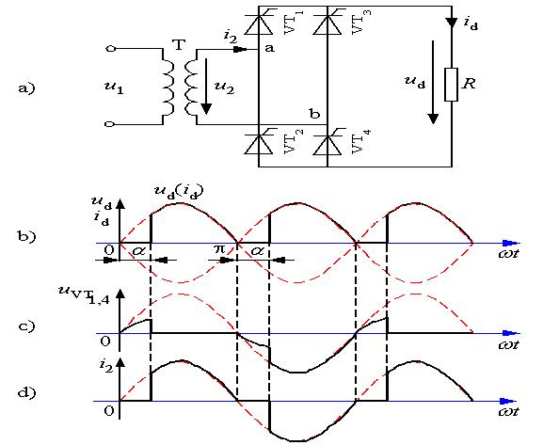
SINGLE PHASE FULL WAVE CONTROLLED RECTIFIERS
Load is resistive

Slide 23
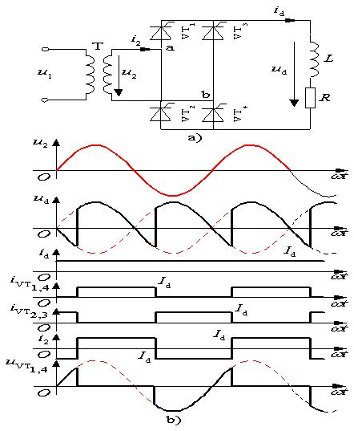
Load is inductive

Slide 24
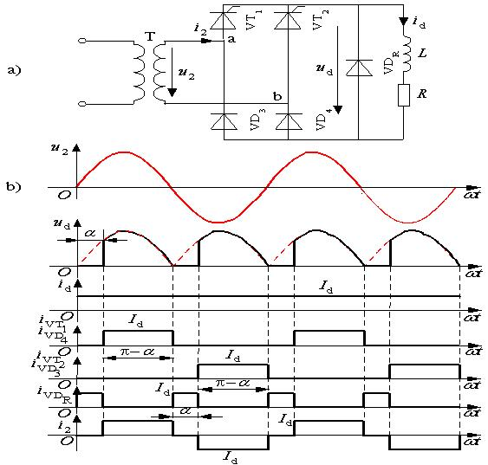
Rectifier with FWD

Slide 25
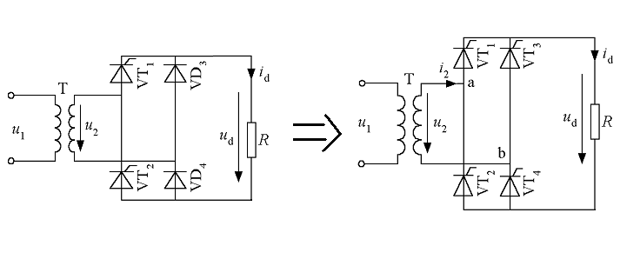

Slide 26
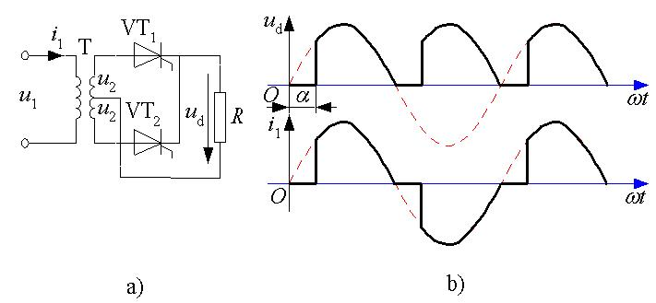
SINGLE PHASE FULL WAVE CONTROLLED RECTIFIERS
Midpoint Rectifier

Slide 27
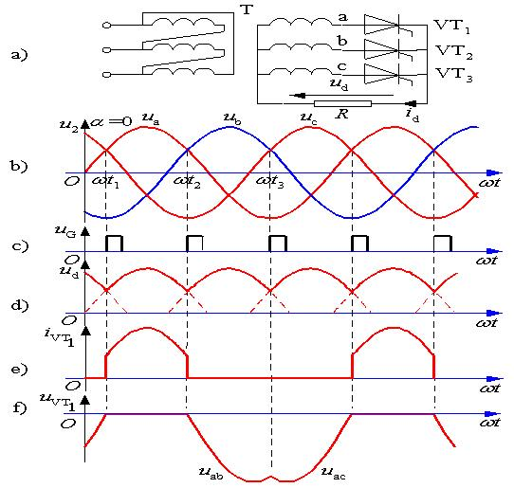
THREE PHASE MIDPOINT RECTIFIERS
Resistive Load
α=0

Slide 28
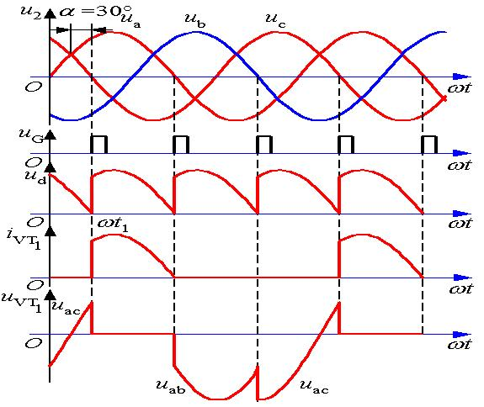
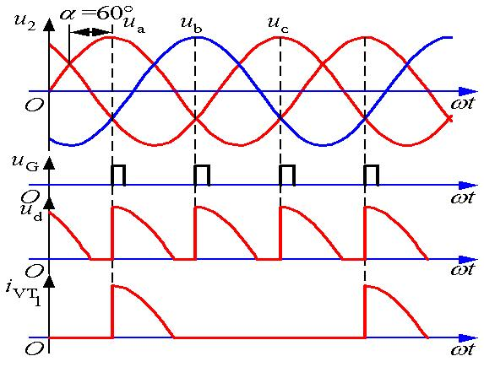
α=30
α=60

Slide 29
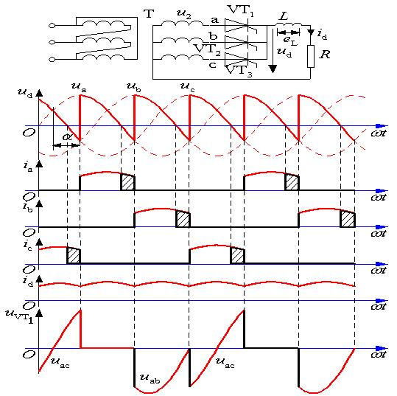
Inductive Load

Slide 30
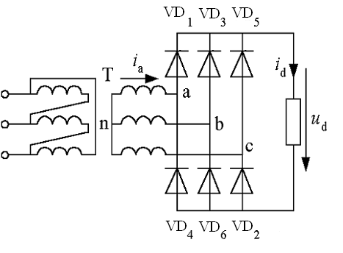
THREE PHASE UNCONTROLLED BRIDGE RECTIFIERS

Slide 31
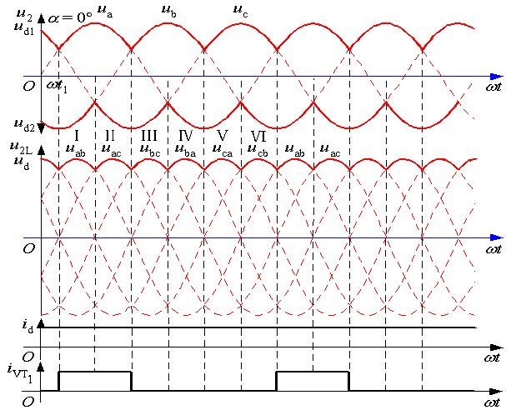

Slide 32
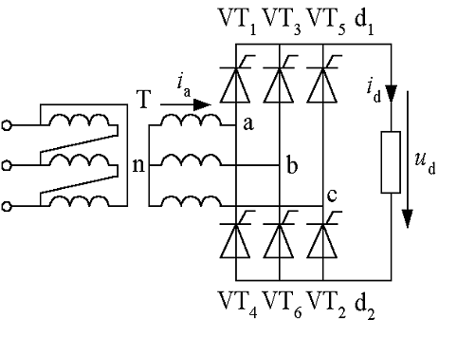
THREE PHASE CONTROLLED BRIDGE RECTIFIERS

Slide 33
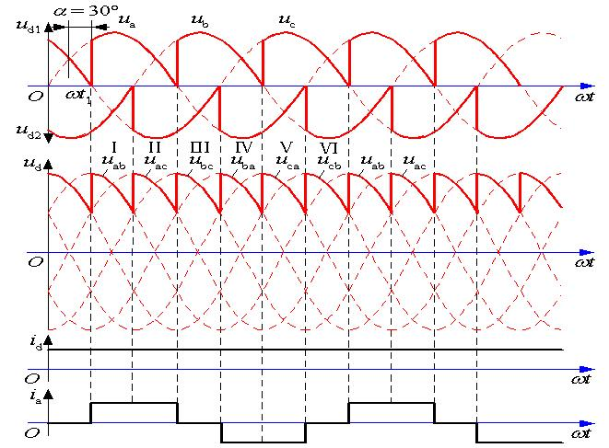
α<60
α=30

Slide 34
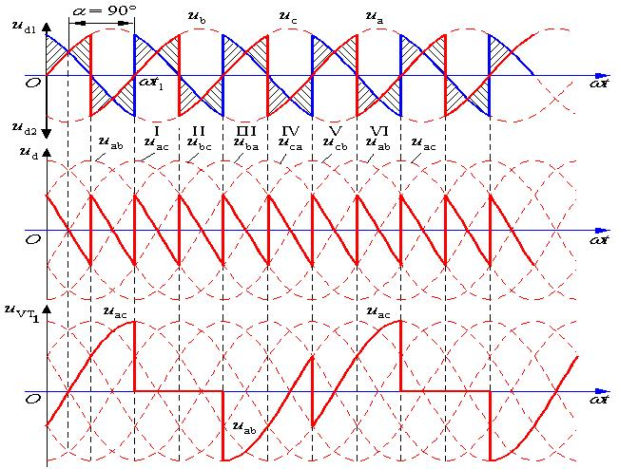
α>60
α=90

